Slide 1
Capstone Project
Relocation MAP Scarborough, Toronto

Slide 2
Introduction
Scarborough is a popular destination for new immigrants in Canada.
It is one of the most diverse and multicultural areas in the Greater Toronto Area.
If people are aware about the new city, the process of relocation, renting or buying a house becomes easier.

Slide 3
Business Problem
People spend so much time researching houses based on price, reputed schools for their children, access to Super market, medical shops, grocery shops, mall, theatre, hospital etc.
The purpose of this project is to explore Scarborough neighborhood so that people find it easy to buy house-based housing prices, access to point of interests and school ratings.

Slide 4
Data Approach
Gather data about the neighborhood, housing prices and school ratings of Scarborough.
Foursquare API will be used as data source for gathering information on neighborhood.
For the housing prices we will use data from “https://www.kaggle.com/mnabaee/ontarioproperties”
To help parents to identify the school reviews we will use data from “https://www.greatschools.org”.

Slide 5
Clustering
we decided to explore neighborhoods, segment them, and group them into clusters to find similar neighborhoods by using K means clustering
K-Means divides the data into non overlapping subsets
We have clustered Scarborough into 5 similar subsets

Slide 6
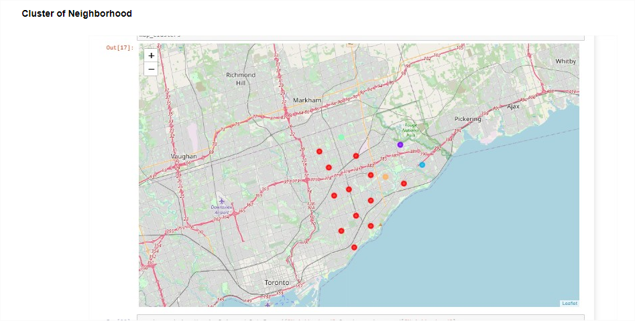
cluster Scarborough Neighborhood

Slide 7
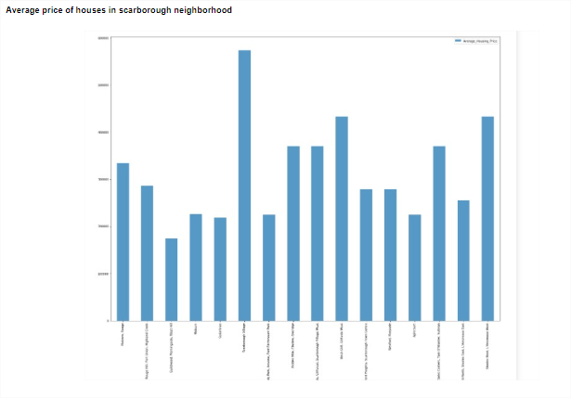
Average price of houses in Scarborough neighborhood

Slide 8
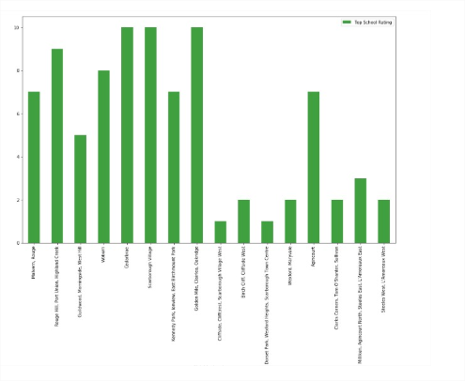
School reviews in Scarborough neighborhood

Slide 9
conclusion
In this project, using k-means cluster algorithm we have divided neighborhoods into 5 different clusters.
Using cluster map, average prices in neighborhood graph and school review graph, people will be able to decide where they would like to relocate.

